Slide 1
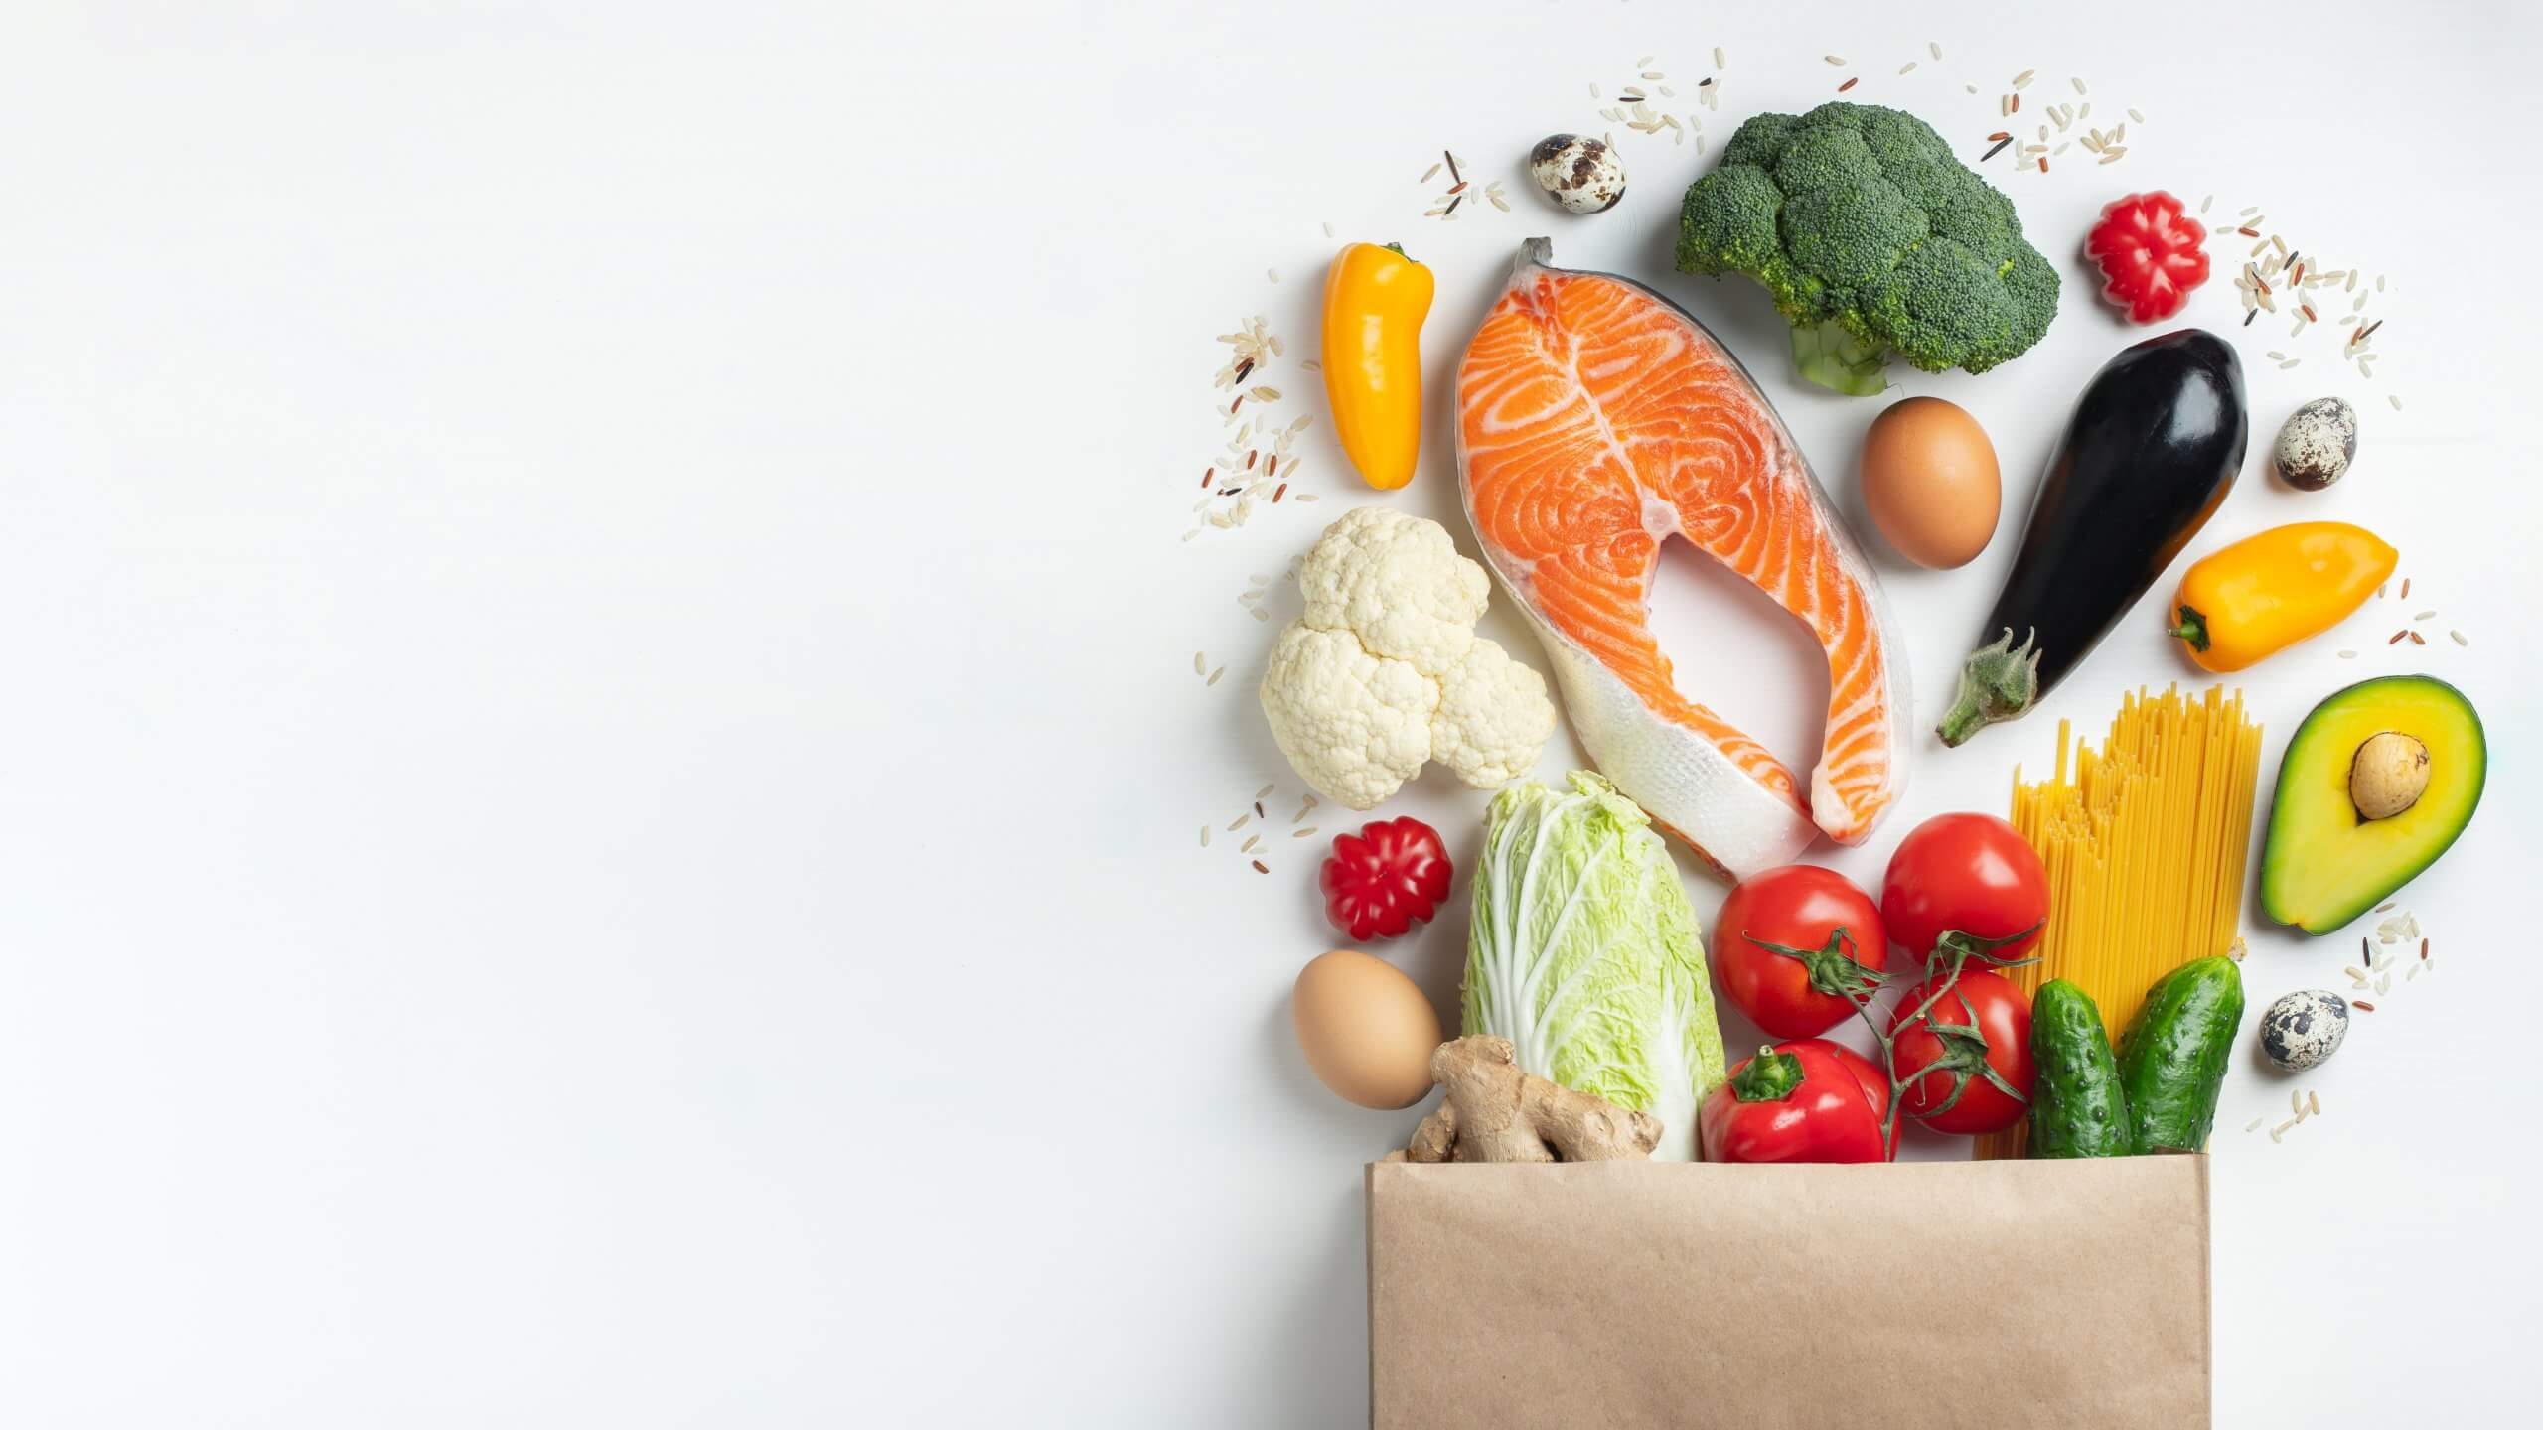
Self-checkout Redesign
RETL 661-095: Design Thinking
By Chiara Lu, MMA ‘24

Slide 2
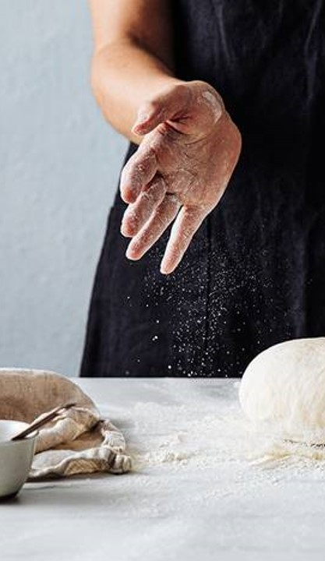
Contents
Research Goals
Background
Empathize with Shoppers
Define Shopper Needs and Problems
Ideate Potential Solutions
Prototypes
1. Scanning Experience
2. Signal Lights
Considerations

Slide 3
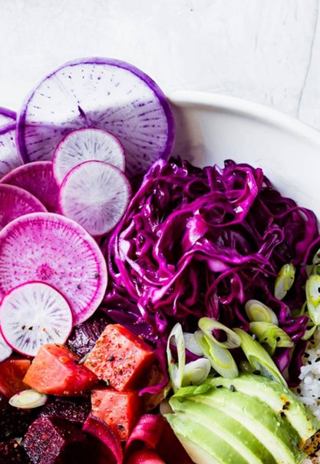
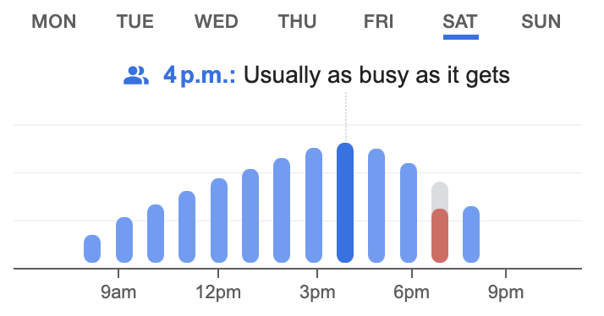
Research Goals
1. UNDERSTAND SHOPPER NEEDS
2. DEFINE SELF-CHECKOUT ISSUES
3. IDEATE POTENTIAL SOLUTIONS
4. CREATE SOLUTION PROTOTYPES
SELF-CHECKOUT KIOSKS
Self-checkout machines were first used in Atlanta, in July 1986^{[1]}. This was a revolutionary innovation for retail stores.
The current installation cost of a standard 4-set kiosk is $125,000^{[2]}.
chances of being selected. On the other hand, convenience sampling is choosing participants who are close to me, like my classmates and friends.
The research is divided into two parts, with 146 Provigo shoppers and 9 participants who were interviewed both in focus groups and individually.
The time of the observation was Saturday January 27, 2024 between 15:12 and 16:46. This time was strategically chosen, because according to Google, it is the busiest time for this particular Provigo grocery store.
METHODOLOGY
Through observation and empathy interviews, an understanding of the perceptions towards self-checkout is obtained. Random sampling and convenience sampling are applied. Random sampling is a generalized way of selecting participants where participants have equal
Source: [1] Erply, [2] The Atlantic

Slide 4
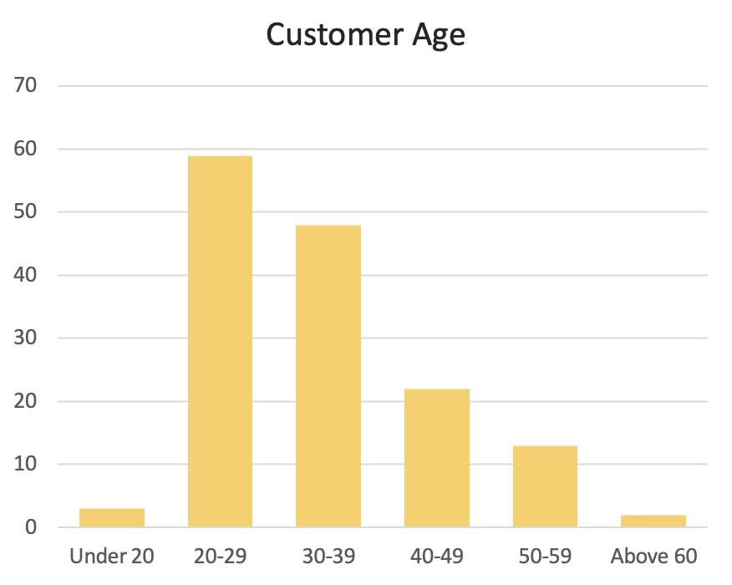
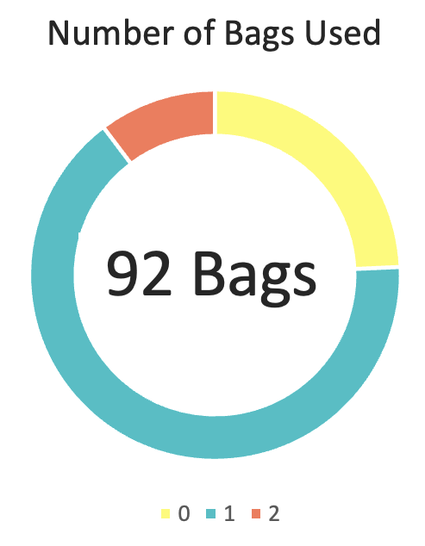
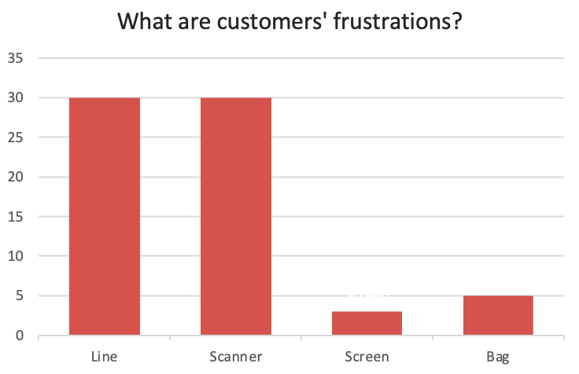


Empathize with Shoppers
DEMOGRAPHY
ADVANTAGES
During the observation timeframe, there were 146 customers, of which 96 were shopping alone. The number of males and females are proportionate.
66% of the customers used 1 bag, 24% used 0, and 10% used 2 bags. This shows that shoppers using self-checkout usually buy moderate to few items.
With respect to convenience, interviewees said:
For introverts, self-checkout helps avoiding interactions with sales representatives. Moreover, some people like the interface of the software and feeling the advancement of technology at their fingertips.
DISADVANTAGES
©
“It’s fast for people who just need to grab and go.”
“I use it when I have few items.”
”I can take it at my own pace.”
32% men had self-checkout issues
25% women had self-checkout issues
20% of the shoppers waited in line. 3% left due to a line. 20% shoppers had issues with the scanner. About 2% had technical difficulties navigating the screen. 3% shoppers did not find bags at the kiosk and asked the staff to get one.

Slide 5
Define Shopper Needs and Problems
Diving deeper into customers’ frustrations, the problem can be broken into several subproblems within the customer journey. A subjective temper level and time length is depicted based on the number of issues shoppers face on average.
Waits in line
Scans items
Scans membership
Pays
Bags items
Exits the store
TEMPER LEVEL
Scanning items like vegetables and fruits often requires staff’s help. Over 44% of the frustrations are about scanning items or cards.
Discounted items are not reflected and need the staff’s card to enter.
Customers can not remove items by themselves.
Waiting for staff to come can slow down the line. 20% of customers explicitly ask for help.
While waiting, the flashing red light annoys some customers.
Some customers have language barriers and the machine is not always starting on the right page.
There is not enough space to put items. This leads to some customers forgetting things behind.
17% of scanning issues are related to scanning membership cards.
For payments, sometimes the staff has to intervene to unlock the screen.
Customers don’t collect printed receipts most of the times. The staff collects and throws the receipts when they accumulate.
TIME
3% customers have issues with missing bags at the kiosk.
Few customers wanted to return or buy more items.
Some customers take time to bag their items, but the light already switches to green (showing that the kiosk is available to the next customer).
Optional step if there is no line.
In a long line, customers can block the isle near the self-checkout area.
Customers choose to go to cashiers if the line is too long.
Self-checkout’s key issues I will focus on are:
Scanning items of a particular category
Annoying flashing lights

Slide 6
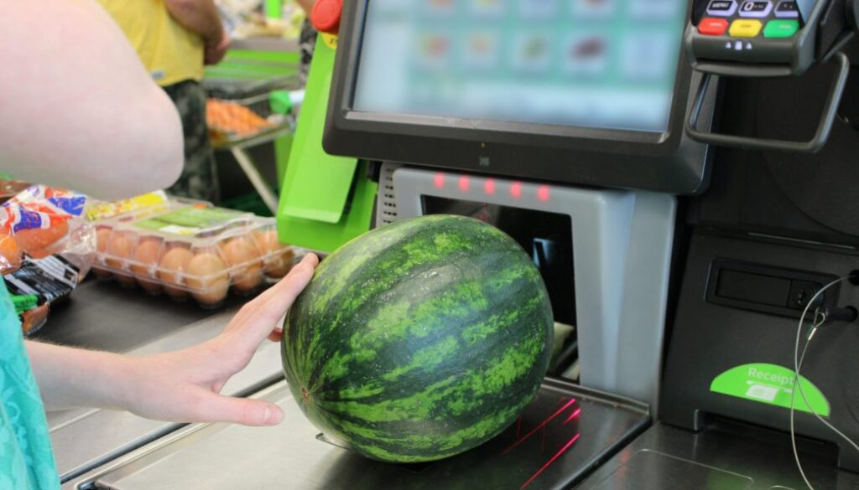
Ideate Potential Solutions for Scanner
What if, the interface offered less options to click from?
What if, the label with the code is made bigger?
How do I scan this watermelon?
I can’t find this product. The interface is too confusing
What if, self-checkout does not allow scanning fresh items from the fruits/vegetables section?
What if, there is a select by product category option to help find the product?
I don’t speak French…
What if, there is a menu with images and are ordered by colour?
What if, the screen starts by default on a welcome and select language page?
What if, there is a list of frequently bought items with their respective code?
What if, there are illustrations on how to enter non-barcoded items?
Quotes are from some of the interviewees.

Slide 7
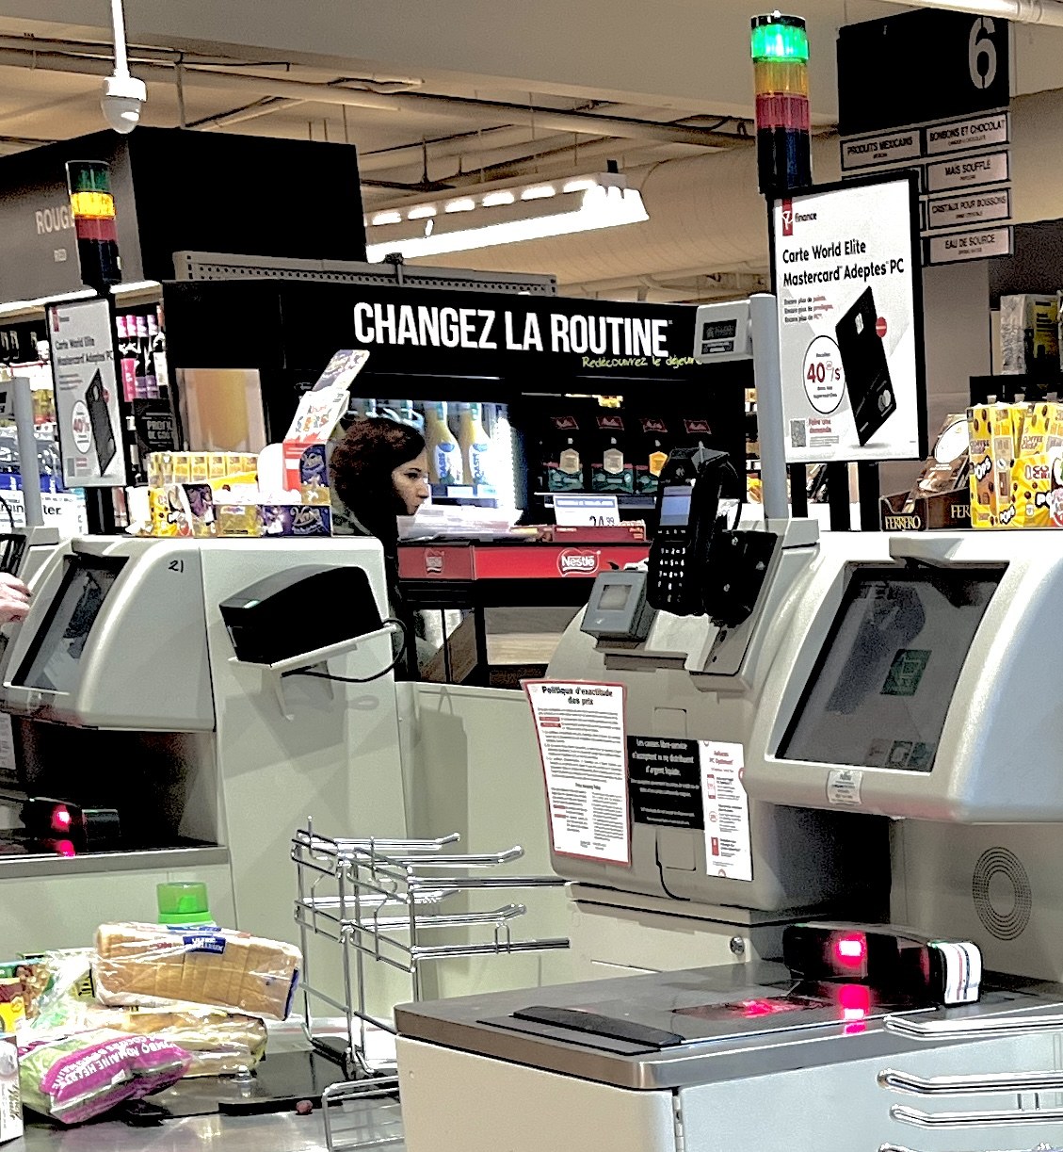
Ideate Potential Solutions for Flashing Light
It’s green.
Finally, it’s my turn!
What if, the store adds staff during peak hours?
What if, the flashing light is replaced with a help flag?
What if, the “needs help” light is not red?
What if, the layout of the self-checkout kiosks is different for better visibility?
Everyone must be watching me now because of the flashing light
What if, the light is not flashing while the customer is waiting?
What if, the light is adjustable in height to improve visibility?
Oh, I didn’t notice that the kiosk is available
What if, there is a screen from the staff’s end seeing who needs help?
What if, there is a feedback system recording help calls and their issue?

Slide 8
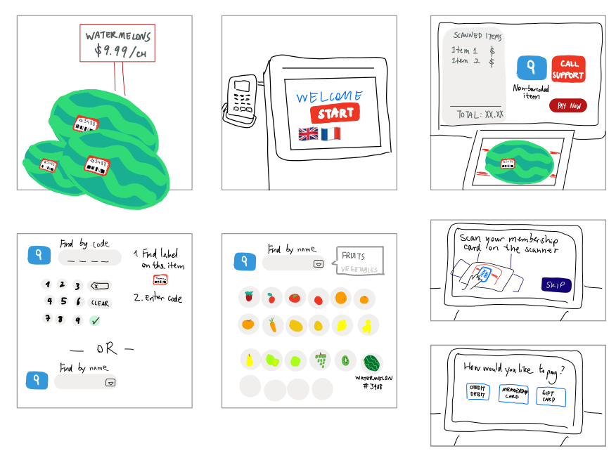
Prototype - Scanning Experience
IMPROVED PROCESS
1
Pick up aN ITEM
When a customer first picks up an item that is normally non-barcoded, they will see an enlarged sticker on it showing the product code.
LARGE STICKER
LANGUAGES
FEW BUTTONS
2
FIND THE ITEM
The interface will begin with “Start” button along with language options. When a screen is inactive for longer than 20 seconds, it will return to its starting page.
The user can search by inserting the code or choosing through images. The images are filtered by category and are ordered by colour rather than in alphabetical order, saving time in searching for the right name.
ORDER BY COLOUR
3
WEIGHT/CHOOSE QUANTITY
The customer selects or weights the items.
4
CHECKOUT THE ITEM
The customer will be prompted by to scan their membership card, along with an image on where to scan. If the customer is not a member, they can skip to payment directly. Using images can effectively show the customer where to scan.
After this step, the customer weights or selects the quantity of the items.

Slide 9
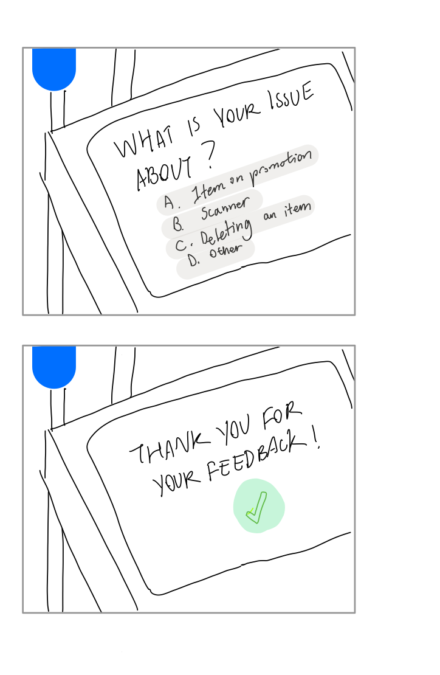
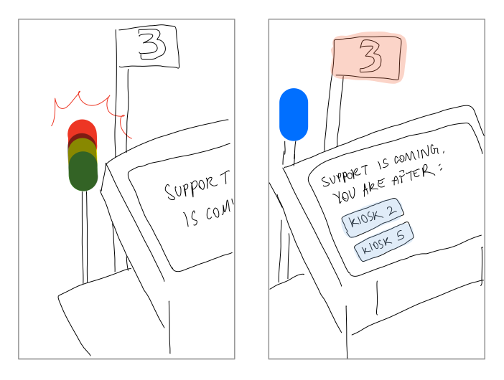
Prototype – Signal Light
BEFORE
AFTER
While waiting, the customer can be prompted with a question asking what their issue is. This data will be saved into a database and will be used later for ad-hoc analysis. Keeping the customer busy also makes time for the staff to get to the kiosk.
During the observation time, I asked the staff working at Provigo what the top reasons customers call for help. The staff mentioned that for items in promotion, the staff needs to verify it. In my focus group interview, interviewees mentioned that they need help finding things, weighting items, and deleting items that have been mistakenly scanned multiple times. Another issue faced by customers is that they might want to return an item, but the current kiosks do not offer a space where items can be discarded. Therefore, they would call for assistance.
With a feedback system in place, a large portion of information is captured for the grocery store to make improvements.
Instead of a blinking traffic light, the “need help” light can be changed to another less alarming colour. The kiosk number can have the red colour instead, to show that the kiosk is occupied. In larger stores, the staff member should have a laptop showing which kiosk is asking for help and the order of which kiosk to help first.

Slide 10



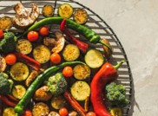
Considerations
1
Self-checkout VS Staff
Self-checkout is not self-checkout if a staff needs to intervene most of the times. Cashiers and staff will hardly be replaced, even with a strong mechanism in place.
Making the labels larger on fruits incurs higher costs, and it does not look pleasing. Imagine picking up an apple and having a big sticker with digits on it.
Ordering products in order of colour can be fast for finding the product, however, current systems are designed for users to search by letters and it can take time for users to accept this new method.
Some grocery stores in Europe, like Carrefour, have weights in the vegetables/fruits section and customers print the label after they weight the items. This is a self-service model that can help saving time at the checkout.
For the signal lights’ prototype, it is important to consider that each grocery stores’ kiosks look different, and some may have different layouts.
In a large grocery store, the staff may not always follow the order of who asked for help first, but instead, they would go to their nearest customer.
Giving options in the feedback system helps categorizing issues for later analysis, however there may be a problem if customers can not find the right description to their problem, or even worse, if they do not read the question and click on the first option given.
2
User Acceptance Testing
Observing how customers perceive and interact with the new designs will be invaluable in refining the design and finding underlying caveats.
3
Design Thinking is an Iterative Process
The next steps of my research would be to conduct more interviews with shoppers showing my prototypes and getting feedback on how they can be improved further.
Source: [2] Mull (2023)

Slide 11
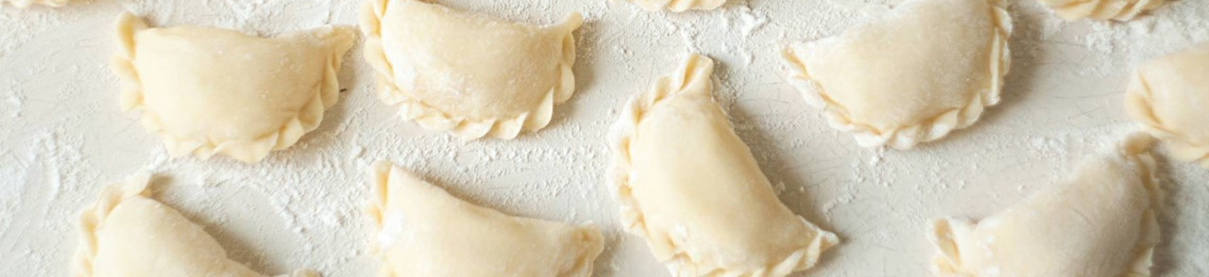
References
Erply. (2023, August 1). The Self-Checkout – the Last-Ditch effort before the No-Checkout stores of the future? https://erply.com/the-self-checkout-the-last-ditch-effort-before-the-no-checkout-stores-of-the-future/#:~:text=According%20to%20NewsOK%2C%20developing%20a,in%20retail%20had%20been%20born.
Mull, A. (2023, October 18). Self-Checkout is a failed experiment. The Atlantic. https://www.theatlantic.com/technology/archive/2023/10/self-checkout-kiosks-grocery-retail-stores/675676/

